Slide 1


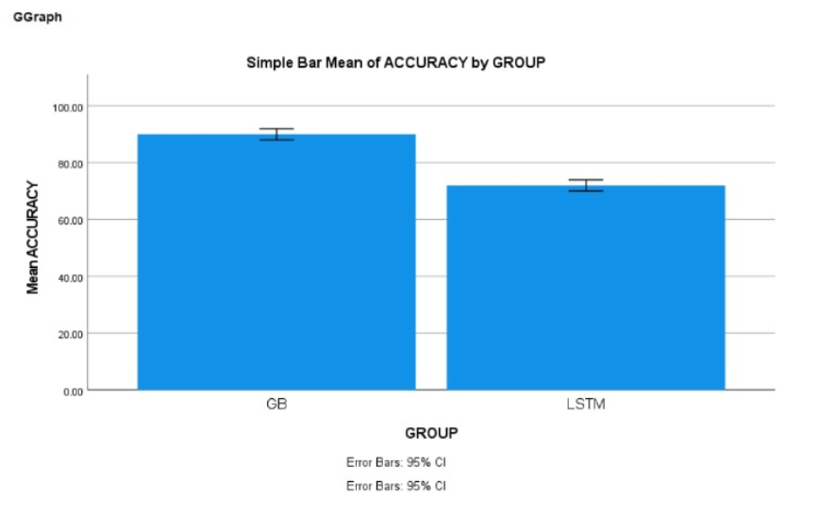
Name: SHAIK ABDUL FAHEEM Register Number: 192321068
Guided by Dr. Manoj.P
Ms. Poorani.S
Guided by Dr. Mary Valantina. G
Analysis of online shopping using Gaussian Blur over LSTM to improve the accuracy.
The aim of this study is to analysis of online shopping using a Guassian Blur algorithm and compare its performance with LSTM algorithm optimization, evaluating their effectiveness in accurate online shopping trajectories based on relevant data input.
Gaussian Blur's ability to extract intricate patterns from data complements the LSTM's robust optimization techniques, leading to enhanced predictive accuracy and insights into online shopping.
In this research study , Gaussian Blur algorithm is compared with different algorithm such as Long Short Term Memory (LSTM) to enhance accuracy.
The advantage of Gaussian Blur (GB) has proven to faster when compared with LSTM algorithm.
INTRODUCTION
Analysis of Online Shopping
MATERIALS AND METHODS
Guassian Blur
Compare
Improved Its Accuracy
Data Collection/
Pre -Processing
Data Training
machine learning algorithm
Long Short-Term Memory
Feature
Engineering
analysis of online shopping
RESULTS
Group Statistics
 | GROUP | N | Mean | Std. Deviation | Std. Error Mean
ACCURACY | GB | 5 | 90.0000 | 1.58114 | 0.70711
 | LSTM | 5 | 72.0000 | 1.58114 | 0.70711
In the present work, Guassian Blur is compared with Long Short – Term Memory (LSTM) and it depicts that the proposed algorithm gives more accuracy when compared with the rest.
DISCUSSION AND CONCLUSION
Based on T-test Statistical analysis, the significance value of p=0.001 (independent sample T - test p<0.05) is obtained and shows that there is a statistical significant difference between the group 1 and group 2.
Overall , the accuracy of the Guassian Blur is 90.00 % and it is better than the other algorithm.
Long Short –Term Memory(LSTM) - 72.00%
From the work , it is concluded that the Guassian Blur algorithm attains the high accuracy when comparing with Long Short –Term Memory (LSTM) Algorithm in analysis of online shopping.
BIBLIOGRAPHY
B. Ko and S. Kwak, “Survey of computer vision based natural disaster warning systems,” Optical Engineering, vol. 51, no. 7, Article ID 070901, 2012. View at: Google Scholar
J. R. Martinez-de Dios, B. C. Arrue, A. Ollero, L. Merino, and F. Gómez-Rodríguez, “Computer vision techniques for forest fire perception,” Image and Vision Computing, vol. 26, no. 4, pp. 550–562, 2008. View at: Publisher Site | Google Scholar
Y. Meng, Y. Deng, and P. Shi, “Mapping Forest Wildfire Risk of the World,” in World Atlas of Natural Disaster Risk, P. Shi and R. Kasperson, Eds., pp. 261–275, Springer Berlin Heidelberg, Berlin, Germany, 2015. View at: Publisher Site | Google Scholar
P. Podržaj and H. Hashimoto, “Intelligent space as a framework for fire detection and evacuation,” Fire Technology, vol. 44, no. 1, pp. 65–76, 2008. View at: Publisher Site | Google Scholar

